Slide 1
Bike Sharing Demand Analysis & Fleet Optimization.
NEXTHIKES IT SOLUTIONS
Represent By: Aswiniranjan Behera
Submission Date: October 10, 2026
Tools Used: Microsoft Excel, Power Query, Pivot Tables, VBA Macros

Slide 2
Problem Statement
Situation Context
[✓]
Operational Inefficiencies — Lack of predictive demand modeling leads to severe bike shortages at transit stations during morning and evening rush peaks.
Analyzing bike-sharing data helps understand how weather, time, and holidays affect bike rentals. Organized data leads to better decisions faster.
[✓]
Data on bike rentals, weather, Demand surges cause empty or overflowed and customer types is collected dock stations during peak commute hours. hourly and daily.
Data Fragmentation & Inconsistent Quality — Ingestion logs across multiple separate files require manual cleaning, deduplication, and lookup joins before analysis is possible.

Slide 3
Data processing
Here I do First
Clean
Merge
Reconcile multi-batch sources

Slide 4
Workflow Stages
Batch A
Batch B
Batch C
(Dataset_1): 610 records containing temporal attributes (dteday, hr, season, holiday) and ambient weather.
(Dataset_2): 610 records containing rental demand metrics (casual, registered, cnt) joined via instant key.
(Dataset_3): 390 supplemental records vertically unioned to extend the temporal timeline through mid-February.

Slide 5
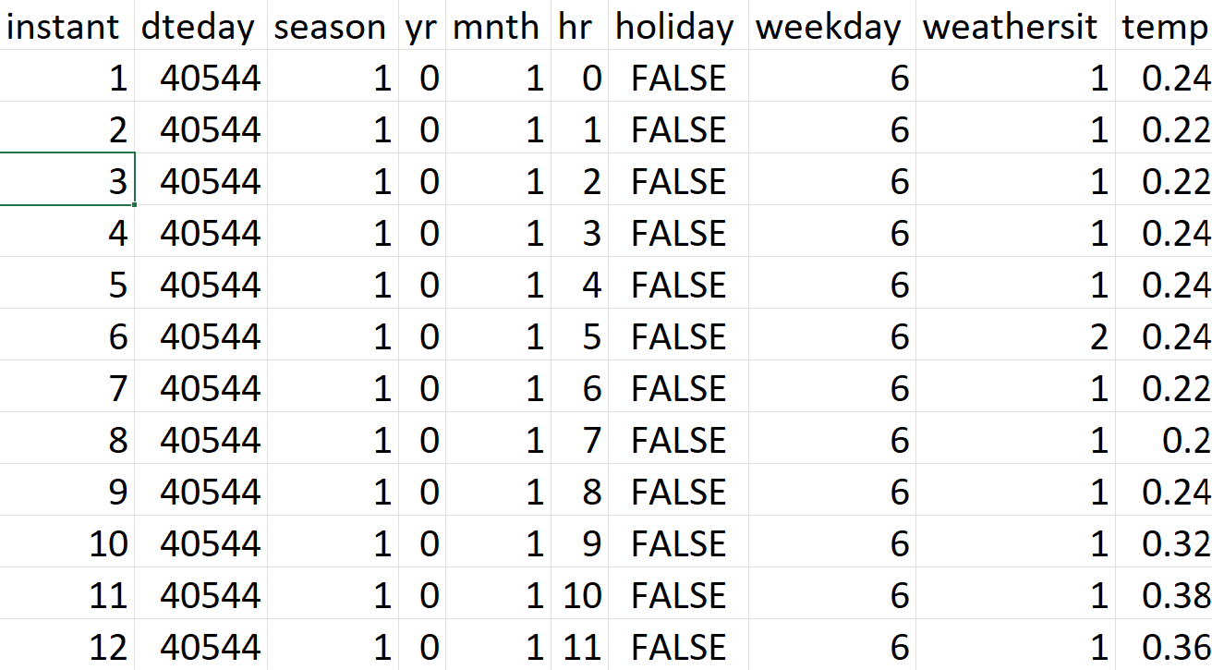
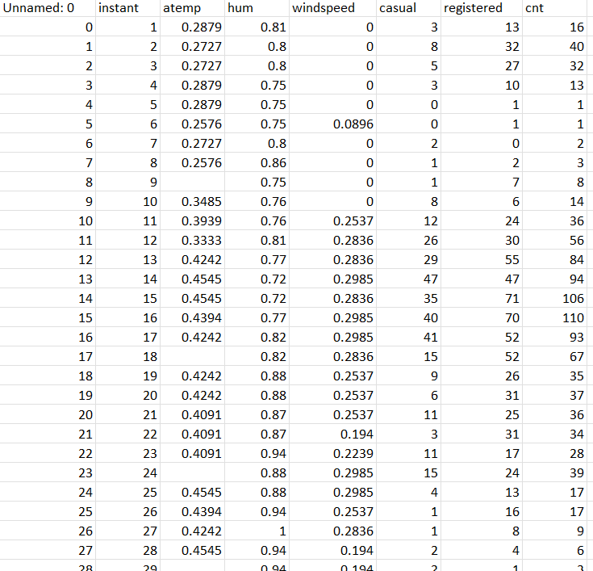
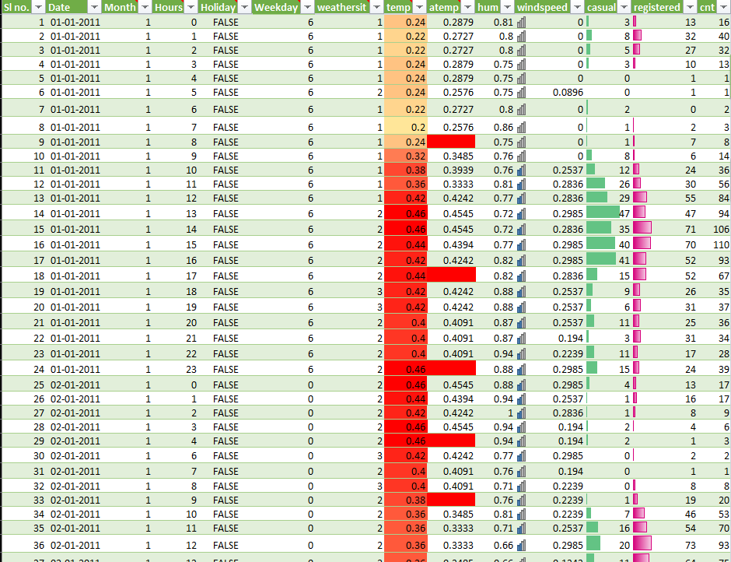
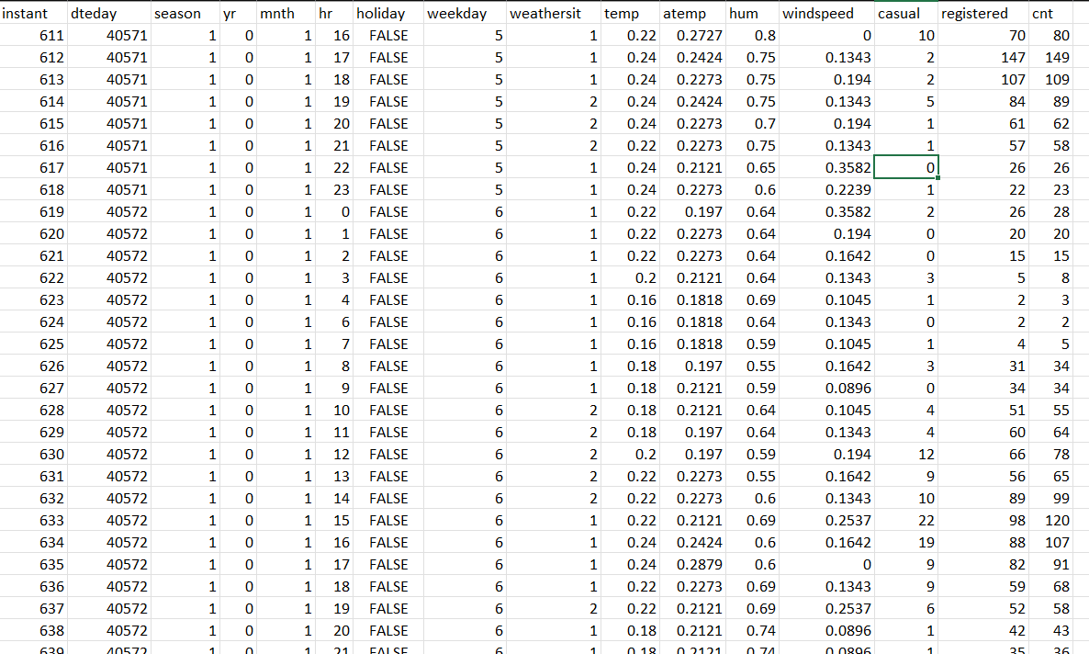
Data Cleansing, Imputation & Type Reconciliation
Raw Ingestion Anomalies
Transformation Applied
vs

Slide 6
Statistical Summary
Weathersit
Atemp (Feeling Temp)
Windspeed
Mean = 1.48
Median = 1.00
Mode = 1
Skewness = +1.044
(Right-skewed, clear-weather predominance).
Mean = 0.212
Median = 0.212
Std Dev = 0.0767
Kurtosis = 0.671
(Symmetric Gaussian behavior).
Mean = 0.195
Median = 0.164
Std Dev = 0.129
Skewness = +0.434
(Mild positive skew)

Slide 7
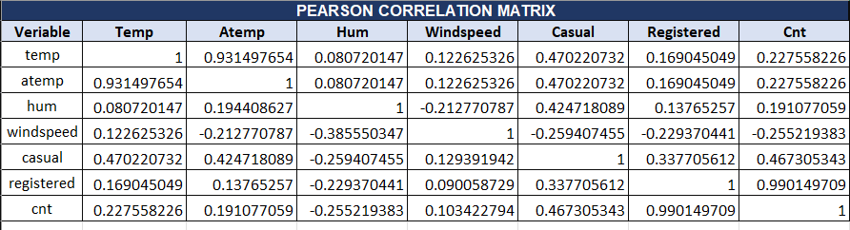
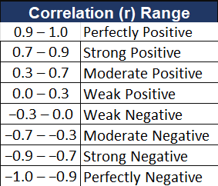
Correlation Findings
Critical Multicollinearity: Both metrics provide redundant thermal signals.
System throughput is almost entirely registered commuter driven.
Elevated relative humidity exerts a consistent suppressing effect on ride demand.
Moderate positive affinity with midday temperature.

Slide 8
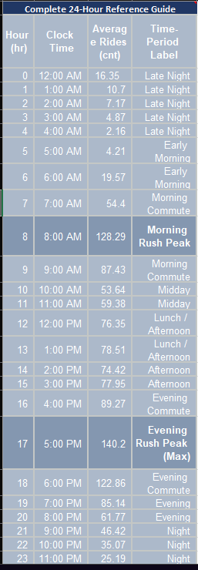


24-Hour Hourly Demand Profile
Bimodal Velocity Peaks
Morning Commute Rush: Hour 08:00 $→$128.29 rides/hr
Evening Commute Surge (Global Peak): Hour 17:00 $→$140.20 rides/hr
Midday Plateau: Hours 12:00–15:00 $→$73.6 – 78.5 rides/hr
Morning Commute Rush: Hour 08:00 $→$128.29 rides/hr

Slide 9
User Segmentation
Registered Commuters (91.7% | 53,383 Rides)
Casual Leisure Users (8.3% | 4,921 Rides)
Strict commuter schedules: Sharp demand surges at 08:00 and 17:00.
Weekend recreational clustering (Sunday casual average: 9.01 rides/hr vs Wednesday: 2.63 rides/hr).
Volume remains resilient on weekdays (Thursday average: 65.0 registered rides/hr).
High sensitivity to cold temperatures and precipitation.

Slide 10
Day-of-Week Utilization & Variance
Weekday Variance Summary
Thursday: 67.66 rides/hr (Weekly Operational Peak)
Tuesday: 66.01 rides/hr
Friday: 65.91 rides/hr
Wednesday: 61.44 rides/hr
Monday: 56.71 rides/hr
Sunday: 49.52 rides/hr
Saturday: 46.32 rides/hr (Lowest overall throughput)

Slide 11
Demand Elasticity:
Clear / Partly Cloudy (Cat 1): 61.67 rides/hr (Baseline benchmark)
Mist / Overcast (Cat 2): 58.44 rides/hr (-5.2% marginal decline)
Light Snow / Rain (Cat 3): 33.20 rides/hr (-46.1% severe drop)
Heavy Precipitation (Cat 4): 36.00 rides/hr (Rare occurrences)
Key Takeaway: Rain and winter snow trigger an instantaneous 46.1% demand drop, creating an immediate opportunity to pull surplus bikes for preventative servicing.

Slide 12
Operational 24-Hour Reference Guide
Time Window | Clock Range | Fleet Velocity | Operational Status & Action
Late Night | 00:00 – 04:00 | 2.16 – 16.35 rides/hr | Low Activity: Maintenance & repair window
Early Morning | 05:00 – 06:00 | 4.21 – 19.57 rides/hr | Staging Phase: Van transfers to transit stations
Morning Commute | 07:00 – 09:00 | 54.40 – 128.29 rides/hr | Critical Rush: Rapid replenishment at metro hubs
Midday Circulation | 10:00 – 15:00 | 53.64 – 78.51 rides/hr | Steady Leisure: Normal dock circulation
Evening Commute | 16:00 – 19:00 | 85.14 – 140.20 rides/hr | Maximum Fleet Load: Peak dock capacity management

Slide 13

KPI Summary
Total Bike Rental
Avg Hourly
Peak Rush Hour
Weather Impact Drop
58198
11.753
17
-0.461

Slide 14
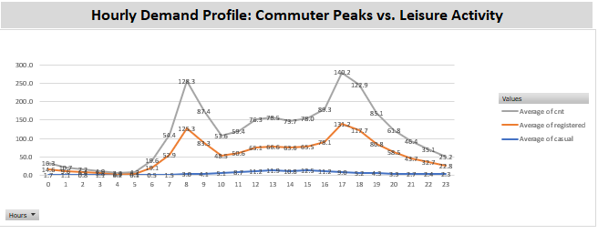

Slide 15
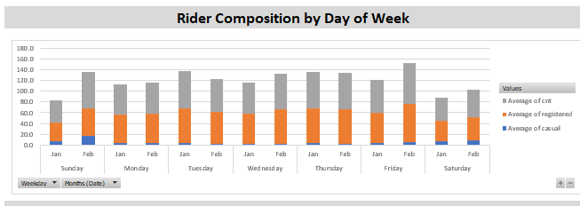

Slide 16
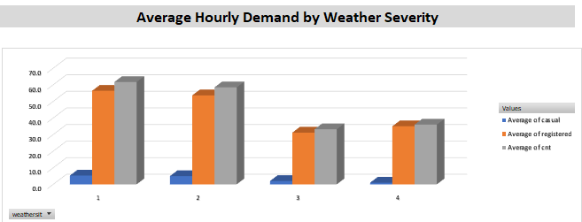

Slide 17
Thank you
— Questions & Discussion
NEXTHIKES IT SOLUTIONS |
[✓] Cleaned & Unified Workbook (Prepocessing final data.xlsx)
[✓] Automated VBA Reporting Scripts & Macro Modules
[✓] Multi-Slicer Interactive BI Executive Dashboard
[✓] Comprehensive Technical Summary Documentation

